Slide 1
Introduction to C++
Section 1.1

Slide 2
Program and Software
A program is a set of instructions given to a computer to execute specific tasks
A software is a collection of programs that work together to achieve a comprehensive objective
Types
Application Software e.g. Microsoft Office, Computer Games, Chrome, etc.
Operating System Software e.g. Windows, LiNUX, etc.
Tailor-made Software/Custom Software e.g. Book-keeping softwares, Accounting softwares, etc.
Input
Program
Instructions to process input to create output
Output

Slide 3
Algorithms
Algorithm
A sequence of precise instructions that leads to a solution
Program
An algorithm expressed in a language the computer can understand

Slide 4
A Simple Example
We will write an algorithm and computer program (in no particular programming language) to read a number from the user from keyboard, multiply it with 5 and display the product on the screen.
Algorithm
Get a numeric input from user and store in variable x
Multiply x by 5 and store the product in variable y
Display the value of y on the screen
Program
x= input from keyboard
y=x*5
Send y to the output screen

Slide 5
Program Design
Programming is a creative process
No complete set of rules for creating a program
Program Design Process
Problem Solving Phase
Result is an algorithm that solves the problem
Implementation Phase
Result is the algorithm translated into a programming language – a program

Slide 6
Program Solving Phase
Be certain the task is completely specified
What is the input?
What information is in the output?
How is the output organized?
Develop the algorithm before implementation
Experience shows this saves time in getting your program to run.
Test the algorithm for correctness
Refine the algorithm successively to get a step-by-step detailed algorithm
Pseudocode is an artificial and informal language that helps programmers develop algorithms, similar to everyday English

Slide 7
Implementation Phase
Translate the algorithm into a programming language
Easier as you gain experience with the language
Compile the source code
Locates errors in using the programming language
Run the program on sample data
Verify correctness of results
Results may require modification of the algorithm and program

Slide 8
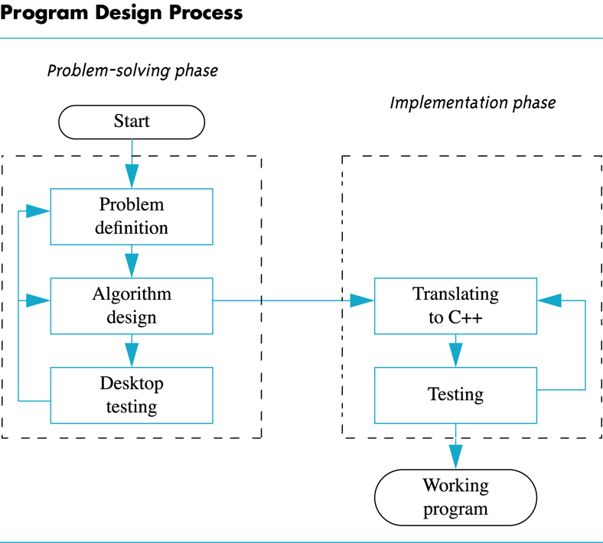
Program Design Process

Slide 9
Exercise: Compute Volume
Write a program to compute the volume of a cylinder of radius r and height h
r
h

Slide 10
Solution: Compute Volume
Problem Solving Methodology
1. Problem Statement
2. Input/Output Description
3. Hand Example
4. Algorithm Development
5. Testing

Slide 11
Solution: Compute Volume (cont’d)
Problem Statement
Compute the volume of a cylinder of radius r and height h
Input/Output Description
radius r
volume v
height h

Slide 12
Solution: Compute Volume (cont’d)
Hand example
r = 2, h = 3, v = 37.68
Algorithm Development
Read radius
Read height
Compute Volume
Print volume
Now convert to a program…

Slide 13
Introduction to C++
Section 1.2

Slide 14
A Sample C++ Program
A simple C++ program begins this way #include <iostream> using namespace std; int main() {
And ends this way return 0; }

Slide 15
Basic Output
cout (see-out) used for output to the monitor
“<<“ (insertion operator) inserts in the data bound for the monitor
Think of cout as a name for the monitor
“<<“ points to where the data is to end up
‘\n’ causes a new line to be started on the monitor

Slide 16
Basic Input
cin (see-in) used for input from the keyboard
“>>” (extraction operator) extracts data from the keyboard
Think of cin as a name for the keyboard
“>>” points from the keyboard to a variable where the data is stored

Slide 17
Introduction to C++
Section 1.3

Slide 18
Comments
Make your code more readable– you can write anything as comment
Compiler will neglect comment– just for reading codes by human, not for machine to execute
Single-line comment
cout<<“Hello”; //This is a single line comment
Multi-line or Block comment
/*
This is start of comment
………..
Comments here
…………..
This is the end of comment
*/

Slide 19
Whitespaces
Make your display more readable by controlling the spacing between characters– output formatting
Typical examples
cout<<“Name \t Age”<<endl; //Horizontal tab whitespace
cout<<“Name Age”<<endl; //Three spaces as whitespaces between Name and Age
cout<<“Name\n Age\n”; //New line feed whitespace

Slide 20
Introduction to C++
Section 1.4

Slide 21
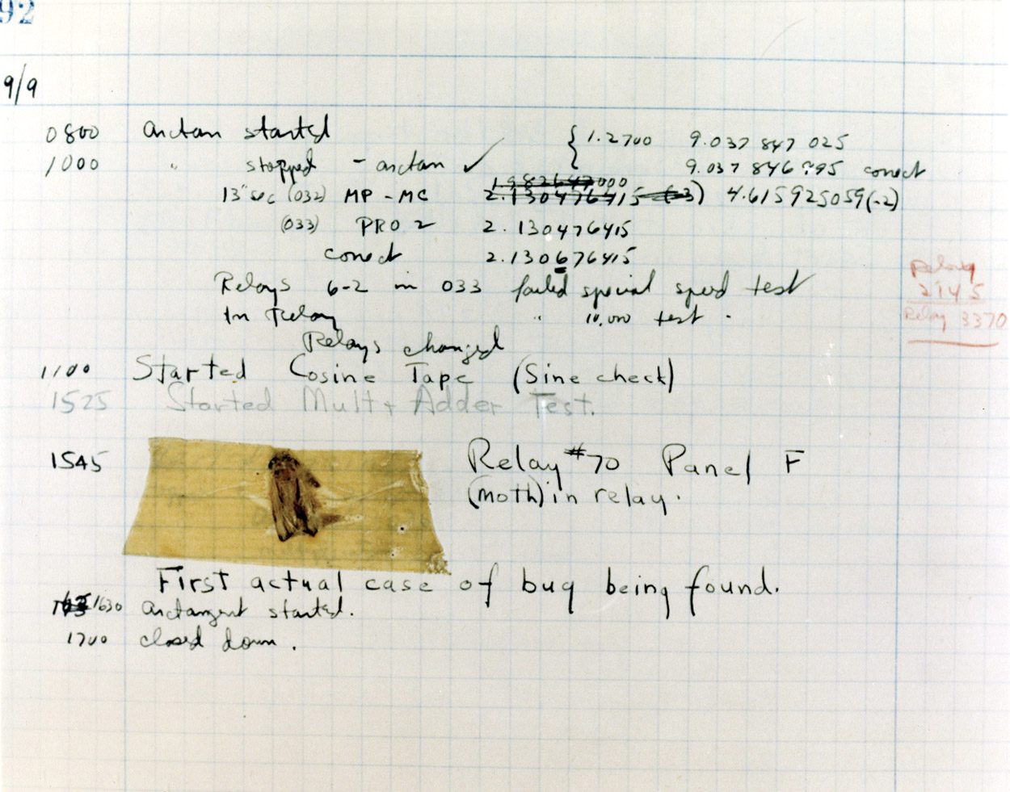
Testing and Debugging
Bug
A mistake in a program
Debugging
Eliminating mistakes in programs
Term used when a moth caused a failed relay on the Harvard Mark 1 computer. Grace Hopper and other programmers taped the moth in logbook stating: “First actual case of a bug being found.”

Slide 22
Program Errors
Syntax errors
Violation of the grammar rules of the language
Discovered by the compiler
Error messages may not always show correct location of errors
Run-time errors
Error conditions detected by the computer at run-time
Logic errors
Errors in the program’s algorithm
Most difficult to diagnose
Computer does not recognize an error

Slide 23
Introduction to C++
Section 1.5

Slide 24
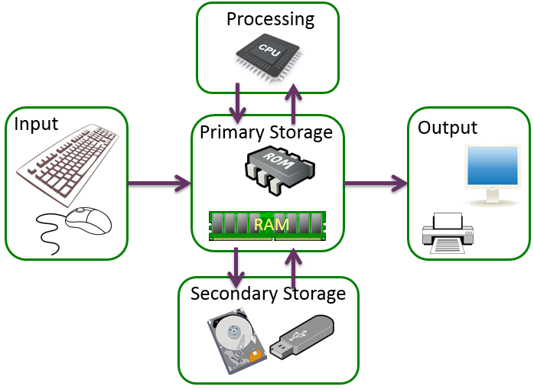
Main Components of a Computer

Slide 25
Introduction to C++
Section 1.6

Slide 26
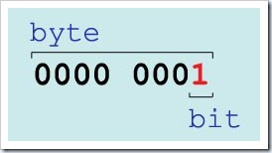
Bits and Bytes
Bit
Short for binary digit
Smallest data unit of a computer
Two states/values represented by 0 and 1
Byte
Sequence of 8 bits
A nibble is a sequence of 4 bits
Binary Unit Conversions
KiloByte | KB | 1 KB | 2^0 KB | 2^10 bytes | 1024 bytes
MegaByte | MB | 1024 KB | 2^10 KB | 2^20 bytes | 1,048,576 bytes
GigaByte | GB | 1024 MB | 2^10 MB | 2^30 bytes | 1,073,741,824 bytes

Slide 27
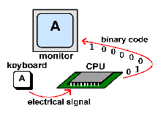

Binary Code
So How Does It Work?
When you type the letter A on your keyboard, electrical signals are sent from the keyboard to the CPU
The CPU turns the signals into binary code
Then, the computer reads the code and sends it on to the monitor to display the letter A
So why is A represented here as
0 1 0 0 0 0 0 1

Slide 28
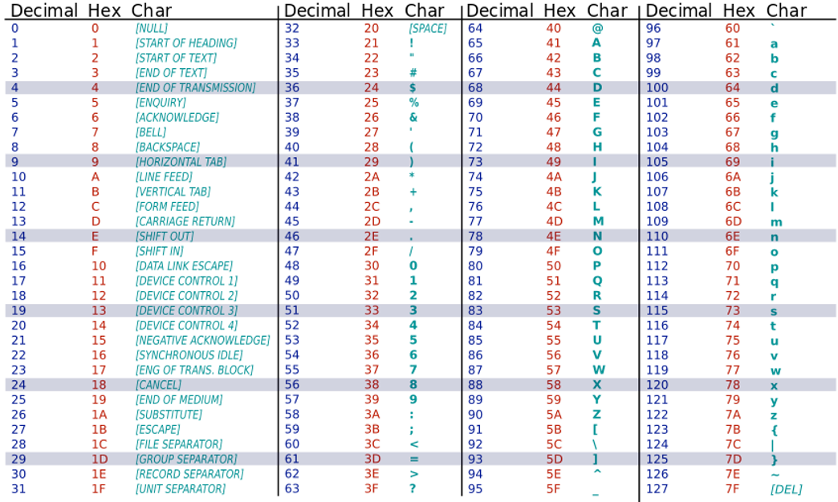
ASCII Table
Every printable and special character encoded as a sequence of bits
ASCII is 7-bit encoding scheme capable of supporting 2^7 = 128 characters

Slide 29
Introduction to C++
Section 1.7

Slide 30
Programming Languages
Three types/levels of programming language
High Level Language
Instructions are given to the computer in using terms that resemble human language
For example, two add 2 and 3, a possible instruction is
ADD 2 3
E.g. C, C++, Java, Python, etc.
Low Level Language/Machine Level Language
The computer does not understand human language
Digital machine that only understands codes in form of binary digits 0 and 1
For example, to perform the same addition we might need to provide an instruction such as
1011 0010 01011
Assembly language

